Slide 1
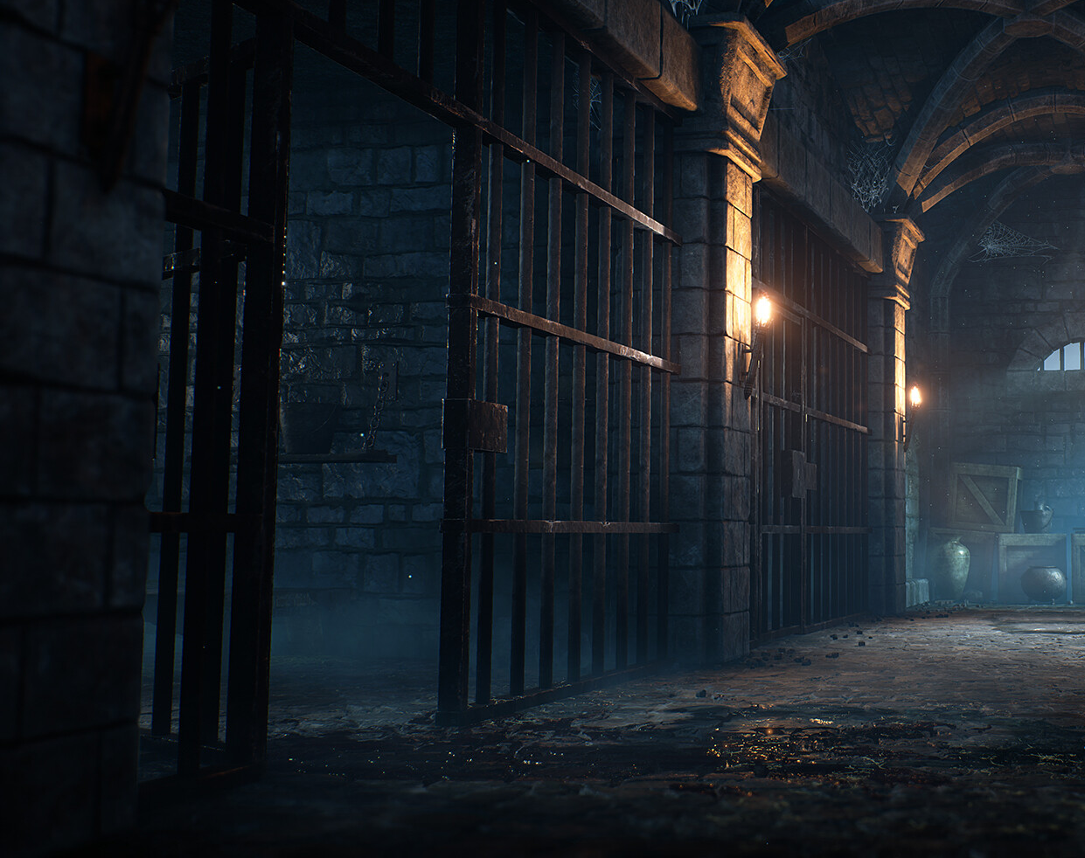
Winner Takes It All
Tomasz Wasilonek, 20210246
Vasco Correia, 50039633
Reference image taken from deviantart.com

Slide 2


Team
Vasco Correia
Tomasz Wasilonek

Slide 3
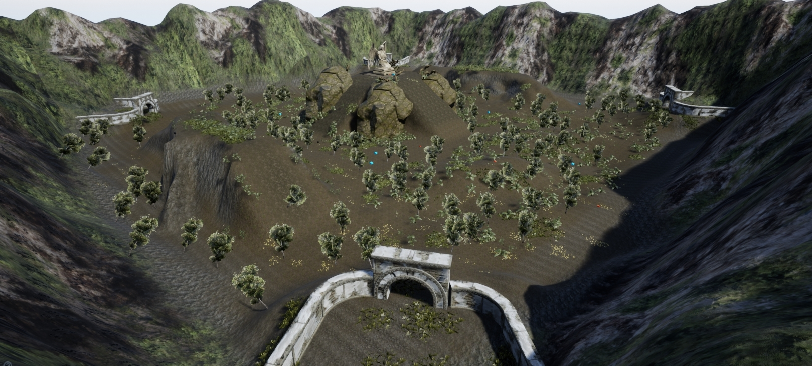
Overview
Windows PC
Multiplayer
2 players
Turn-based strategy game
Isometric birds view camera

Slide 4
Gameplay Overview
Game runs in a loop
3 phases: Movement phase, combat phase, after combat phase
Collect loot and strategize positions
Last survivor wins
Movement phase
Combat phase
After Combat phase

Slide 5
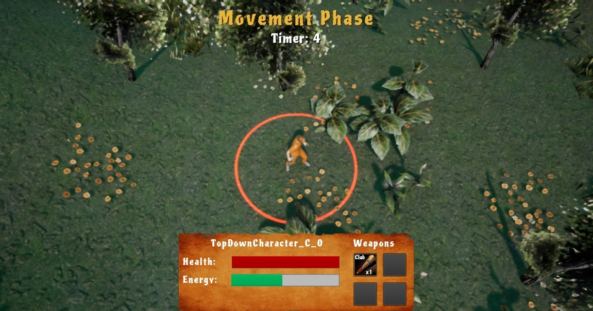
Movement phase
Use this phase to explore and collect loot
Player use have limited stamina
Lasts 15 seconds

Slide 6
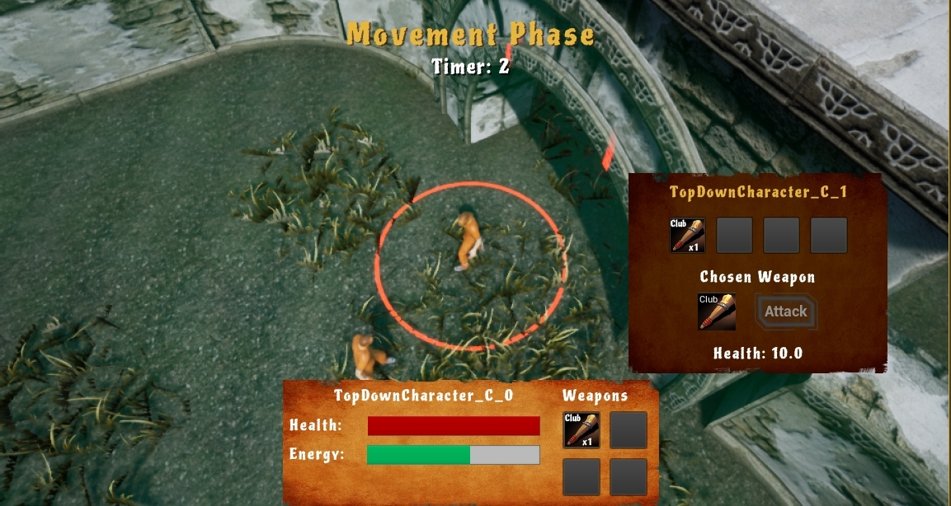
Combat phase
No movement allowed, used to fight
Can choose between different weapons to attack another player
Lasts 5 seconds
All attack occur when it finishes

Slide 7

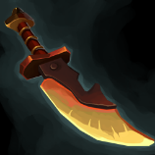


Weapons
Weapon | Damage | Range | Sprite
Club (default) | 1 HP | 200 units
Knife | 3 HP | 200 units
Throwable brick | 2 HP | 700 units
Hand Bomb | 3 HP | 600 units

Slide 8
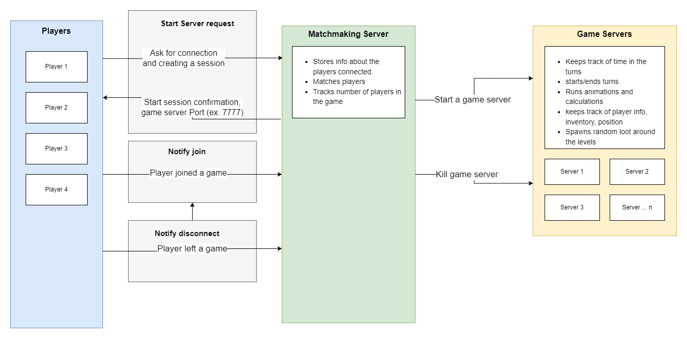
Networking

Slide 9
Demonstration

